Slide 1



Evaluation of Stepping Up efforts to improve mental health services and justice utilization
Benjamin J. Mackey, M.A. and Kendra Clark, Ph.D.
George Mason University

Slide 2

What is our study?
Research project funded by the National Institute of Mental Health (R01 MH118680)
Evaluating the Stepping Up Initiative
Taking place beginning September 2019 through August 2024
This is an implementation research study

Slide 3
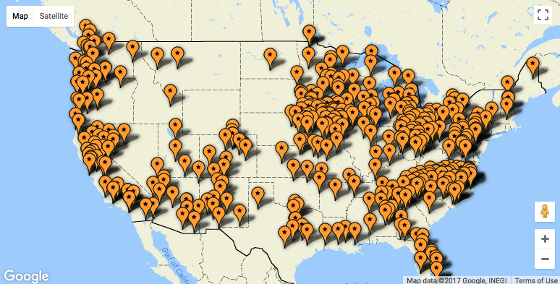
Methods: Counties and Time Frames
We will survey 4 people each from 475 Stepping Up and 475 matched comparison counties:
  Behavioral health administrator
  Jail administrator
  Probation chief
  Substance abuse administrator
Surveys will take place at study baseline, 18 months, and 36 months later
This will result in over 11,000 potential interviews in addition to 270 qualitative interviews

Slide 4
Logic Model
Stepping Up Strategies
Mechanisms
Outcomes
# Clients served with EBPP
# EBPP available
$ spent on EBPP
Use/functioning of interagency teams
Analyze existing community and jail services and make a plan for addressing gaps
Use of/capacity for performance monitoring
Implement the plan and prioritize funds
Identify MH screening tool; develop capacity to use screening tool and track 4 specific indicators on an ongoing basis
Collect baseline data using the screening tool
Track implementation progress on an ongoing basis using the screening took and the 4 indicators
Common goals/mission across agencies and System integration
Convene policy team

Slide 5
What will we know when we’re done?
This study of an ongoing natural experiment (i.e., Stepping Up) is an unprecedented opportunity to evaluate multi-system justice and mental health implementation efforts on a national scale to elucidate effective strategies for bringing Evidence-Based practices to vulnerable and underserved populations

Slide 6
Availability of Mental Health Practices

Slide 7
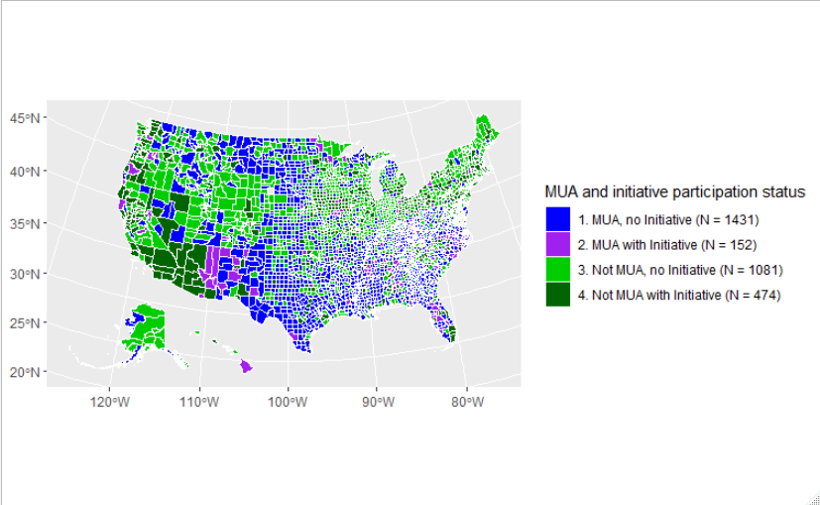
Gaps in Service Delivery are Problematic
28% of Counties Participate in Demonstration Projects (Federal Grants)
Medically served counties:
  Higher proportion of counties
  participating in initiatives
  Concentrated in the West and Northeast
Medically underserved counties:
  Concentrated throughout the south and north-central US
  Less likely to participate in Federal Grants)
*MUA refers to counties that are medically underserved for mental health. The metric is calculated by HRSA
Notes:
Medically served with bullets then medically underserved with bullets.
Add a definition under legend of medically underserved.
Identify that we are identifying the gap (medical underserved).
Discuss that this is imperative because we are looking at counties and not state/national level. This information really shows that all counties are difference with their own unique challenges.
Also say something reassuring to small counties. There are strategies out there to help jurisdictions of any size to better help their residents in terms of health and CJ factors.

Slide 8
Availability of Mental Health Evidence-Based Practices and Policies
across U.S. counties
Practice | % of Counties | % of US Population
Diversion from criminal justice action to mental health treatment | 36.7 | 75.7
Problem solving court | 41.6 | 86.9
Crisis Intervention Teams (co-responding model) | 35.9 | 74.0
Crisis call-in centers | 40.3 | 80.0
Mental health treatment required by the court | 42.0 | 87.9
Shared decision making in mental health treatment planning | 35.8 | 70.8
Coordination between jail and community services (hand-off) | 38.3 | 79.3
Medicaid eligibility continuity | 29.3 | 57.1
Mental health peer navigators, peer advocacy, or peer support | 34.2 | 71.6
Permanent supportive housing for individuals with mental health conditions | 29.2 | 62.5
Supported employment for individuals with mental health conditions | 30.6 | 62.0
Family or caregiver education and support about the patient’s mental illness | 31.1 | 63.2
Trauma-informed care, settings, or services | 36.6 | 76.5
Available but not accessible (small ns)

Slide 9
 | % of Counties | % of US Population
Any treatment for depression | 43.0 | 88.2
Cognitive-behavior therapy (CBT) or Behavioral Activation | 40.5 | 78.1
Interpersonal psychotherapy (IPT) | 25.9 | 50.8
Selective serotonin reuptake inhibitors | 33.1 | 61.9
Any treatment for post-traumatic stress disorder (PTSD) | 40.7 | 85.2
Cognitive-behavioral therapy (CBT) or cognitive processing therapy | 41.0 | 77.4
Prolonged exposure | 25.8 | 50.6
Seeking Safety | 31.8 | 61.5
SSRIs or tricyclic antidepressants | 37.4 | 69.1
Anticonvulsants for re-experiencing | 25.2 | 47.0
Any treatment for anxiety | 40.5 | 78.1
Exposure therapies or cognitive-behavioral therapy (CBT) | 36.0 | 68.4
SSRIs or tricyclic antidepressants | 37.6 | 71.1
Diagnosis-Specific Mental Health Treatments

Slide 10
Diagnosis-specific mental health treatments
Any treatment for depression | 43.0 | 88.2
Cognitive-behavior therapy (CBT) for depression or Behavioral Activation for depression | 40.5 | 78.1
Interpersonal psychotherapy (IPT) for depression | 25.9 | 50.8
Selective serotonin reuptake inhibitors for depression | 33.1 | 61.9
Any treatment for bipolar disorder or mania | 42.3 | 87.9
Mood stabilizers for bipolar disorder or mania | 43.2 | 80.4
Education about bipolar disorder and its treatment (> 1 session) | 39.1 | 72.2
Family education about bipolar disorder or family treatment for bipolar disorder | 32.9 | 65.2
Any treatment for schizophrenia or psychosis | 41.6 | 84.5
Cognitive-behavioral therapy (CBT) for psychosis | 38.6 | 72.9
Family education about schizophrenia or psychosis | 33.7 | 62.9
Social skills training for schizophrenia | 34.7 | 64.9
First generation antipsychotics | 31.8 | 55.1
Second generation antipsychotics | 30.9 | 55.1
Any treatment for borderline personality disorder | 37.4 | 77.7
Dialectical behavior therapy (DBT) | 35.5 | 59.0
Medications for borderline personality disorder | 40.4 | 68.0
Any treatment for post-traumatic stress disorder (PTSD) | 40.7 | 85.2
Cognitive-behavioral therapy (CBT) for PTSD or cognitive processing therapy for PTSD | 41.0 | 77.4
Prolonged exposure for PTSD | 25.8 | 50.6
Seeking Safety | 31.8 | 61.5
SSRIs or tricyclic antidepressants for PTSD | 37.4 | 69.1
Anticonvulsants for re-experiencing | 25.2 | 47.0
Any treatment for anxiety | 40.5 | 78.1
Exposure therapies or cognitive-behavioral therapy (CBT) for anxiety | 36.0 | 68.4
SSRIs or tricyclic antidepressants for anxiety | 37.6 | 71.1
Any group or individual counseling for insomnia | 26.8 | 55.6
Any group or individual counseling for physical pain | 22.8 | 42.2
Any group or individual intervention addressing suicidal thoughts or behaviors | 40.7 | 82.5
Dialectical behavior therapy (DBT) | 30.3 | 66.0
Cognitive behavior therapy (CBT) for suicide prevention | 34.6 | 74.0
The Safety Planning Intervention | 30.0 | 61.2
Availability of Mental Health Evidence-Based Practices and Policies across U.S. counties
Practice | Estimated % of counties | Estimated % of US population
General approaches
Diversion from criminal justice action to mental health treatment | 36.7 | 75.7
Problem solving court | 41.6 | 86.9
Therapeutic walk-in or crisis centers | 31.2 | 66.0
Crisis Intervention Teams (co-responding model) | 35.9 | 74.0
Crisis call-in centers | 40.3 | 80.0
Mental health treatment required by the court | 42.0 | 87.9
Building an alliance with patients and taking patient preferences into account in mental health treatment planning | 35.8 | 70.8
Integrated mental health and substance use services; integrated dual disorder programs | 40.6 | 84.9
Coordination between jail and community mental health services at transitions into or out of jail (e.g., hand-off procedures) | 38.3 | 79.3
Medicaid eligibility continuity | 29.3 | 57.1
Mental health peer navigators, peer advocacy, or peer support | 34.2 | 71.6
Permanent supportive housing for individuals with mental health conditions | 29.2 | 62.5
Supported employment for individuals with mental health conditions | 30.6 | 62.0
Assertive community treatment (ACT), Forensic assertive community treatment (FACT), or Forensic Intensive Case Management (FICM) for mental illness | 27.2 | 60.4
Critical Time Intervention -OR- Case management for mental illness | 32.1 | 65.2
Family or caregiver education and support about the patient’s mental illness | 31.1 | 63.2
Trauma-informed care, settings, or services | 36.6 | 76.5

Slide 11
Availability of Mental Health Evidence-Based Practices and Policies across U.S. counties
Practice | Estimated % of counties with practice available to justice-involved individuals | Estimated % of US population living in counties where practice is available to justice-involved individuals
Diversion from criminal justice action to mental health treatment | 36.7 | 75.7
Problem solving court | 41.6 | 86.9
Therapeutic walk-in or crisis centers | 31.2 | 66.0
Crisis Intervention Teams (co-responding model) | 35.9 | 74.0
Crisis call-in centers | 40.3 | 80.0
Mental health treatment required by the court | 42.0 | 87.9
Building an alliance with patients and taking patient preferences into account in mental health treatment planning | 35.8 | 70.8
Integrated mental health and substance use services; integrated dual disorder programs | 40.6 | 84.9
Coordination between jail and community mental health services at transitions into or out of jail (e.g., hand-off procedures) | 38.3 | 79.3
Medicaid eligibility continuity | 29.3 | 57.1
Mental health peer navigators, peer advocacy, or peer support | 34.2 | 71.6
Permanent supportive housing for individuals with mental health conditions | 29.2 | 62.5
Supported employment for individuals with mental health conditions | 30.6 | 62.0
Assertive community treatment (ACT), Forensic assertive community treatment (FACT), or Forensic Intensive Case Management (FICM) for mental illness | 27.2 | 60.4
Critical Time Intervention -OR- Case management for mental illness | 32.1 | 65.2
Family or caregiver education and support about the patient’s mental illness | 31.1 | 63.2
Trauma-informed care, settings, or services | 36.6 | 76.5

Slide 12
Diagnosis-specific mental health treatments
 | % of Counties | % of US Population
Any treatment for depression | 43.0 | 88.2
Cognitive-behavior therapy (CBT) for depression or Behavioral Activation for depression | 40.5 | 78.1
Interpersonal psychotherapy (IPT) for depression | 25.9 | 50.8
Selective serotonin reuptake inhibitors for depression | 33.1 | 61.9
Any treatment for bipolar disorder or mania | 42.3 | 87.9
Mood stabilizers for bipolar disorder or mania | 43.2 | 80.4
Education about bipolar disorder and its treatment (> 1 session) | 39.1 | 72.2
Family education about bipolar disorder or family treatment for bipolar disorder | 32.9 | 65.2
Any treatment for schizophrenia or psychosis | 41.6 | 84.5
Cognitive-behavioral therapy (CBT) for psychosis | 38.6 | 72.9
Family education about schizophrenia or psychosis | 33.7 | 62.9
Social skills training for schizophrenia | 34.7 | 64.9
First generation antipsychotics | 31.8 | 55.1
Second generation antipsychotics | 30.9 | 55.1
Any treatment for borderline personality disorder | 37.4 | 77.7
Dialectical behavior therapy (DBT) | 35.5 | 59.0
Medications for borderline personality disorder | 40.4 | 68.0
Any treatment for post-traumatic stress disorder (PTSD) | 40.7 | 85.2
Cognitive-behavioral therapy (CBT) for PTSD or cognitive processing therapy for PTSD | 41.0 | 77.4
Prolonged exposure for PTSD | 25.8 | 50.6
Seeking Safety | 31.8 | 61.5
SSRIs or tricyclic antidepressants for PTSD | 37.4 | 69.1
Anticonvulsants for re-experiencing | 25.2 | 47.0
Any treatment for anxiety | 40.5 | 78.1
Exposure therapies or cognitive-behavioral therapy (CBT) for anxiety | 36.0 | 68.4
SSRIs or tricyclic antidepressants for anxiety | 37.6 | 71.1
Any group or individual counseling for insomnia | 26.8 | 55.6
Any group or individual counseling for physical pain | 22.8 | 42.2
Any group or individual intervention addressing suicidal thoughts or behaviors | 40.7 | 82.5
Dialectical behavior therapy (DBT) | 30.3 | 66.0
Cognitive behavior therapy (CBT) for suicide prevention | 34.6 | 74.0
The Safety Planning Intervention | 30.0 | 61.2

Slide 13
Economic Evaluation

Slide 14
Aims/goals
Describe variation in funding of mental health and SU services across counties
Describe association between funding of mental health and substance use services and
  Status of Stepping up (participant versus control county)
  Usage of Evidence based policies and practices.

Slide 15
Most counties did not have a change in funding for mental health and substance use services regardless of agency type
Funding for Mental Health and Substance Use Services

Slide 16
Commonly, staff were not sure how funding changed for all medical services.
Funding for All Medical Services

Slide 17
Funding for medications did not change for most staff, except for community corrections where most staff were unsure
Funding for Medications

Slide 18
Further analysis
Looking at the association between funding and stepping up participation status – to identify funding differences between these counties
Look at the association between funding availability and the usage of EBPPs, both in what kinds of EBPPs are used and the total number that are implemented.

Slide 19
Scales Developed for the Stepping Up Survey

Slide 20
Paper Aims
To develop latent constructs (scales) to measure implementation approaches, county readiness and difficulties to implement changes, and interagency collaborative efforts.

Slide 21
Data and Methods
792 respondents from 522 counties across the U.S.
To build scales on different items of this survey, exploratory factor analysis (EFA) and reliability analysis were performed.
9 scales in three main sets of latent constructs, were developed.
All reliability measures were between 0.70 and 0.91

Slide 22
Scale Set 1: Implementation Approaches
Four latent constructs were developed to measure implementation approaches
  Relationship-Building: explaining the strategies agencies use to form relationships with other agencies within their county and/or state, consisted of nine items with a Cronbach alpha reliability measure of .908.
  Capacity-Building: explaining the overall behavioral healthcare service capacity improvement strategies of different agencies within counties, consisted of six items with an alpha reliability measure of .770.
  Quality Programming: explaining the programming and performance monitoring efforts of counties, consisted of 11 items with an alpha reliability measure of .866.
  Shared Definitions: explaining the development of agreed-up

Slide 24
Scale Set 2: County Readiness and Difficulties for Implementing Changes
Two latent constructs were developed to measure county readiness and difficulties to implement changes
  Readiness: measuring how ready agencies believed their counties are in adopting new strategies, having action plans and resources in place, and implementing changes to achieve their goals.
  Difficulties: reflecting the difficulties and barriers they felt they had to implement changes and achieve their goals regarding providing services in the community for individuals with mental illness or substance use disorder.

Slide 26
Scale Set 3: Interagency Collaborative Efforts
Three latent constructs were developed related to interagency collaborative efforts:
  Coordination: measuring the coordination efforts of agencies within each county
  Integrated care
  Data capacity: measuring the data capacity of agencies within each county that supports them for interagency efforts.

Slide 28
Implementation Strategies

Slide 29

With 10.3 million jail admittances per year– many of them individuals with behavioral health conditions (SMI/SUD)– counties across the country are implementing evidence-based practices to reform the jail system
National Initiatives
Evidence-Based Practices Umbrella
Grant
Programs
Stepping Up
Friendly Faces
MacArthur Safety & Justice Challenge
Etc.
Second Chance Act
HEAL
CSAT drug court initiatives
Etc.
Programs/Policies
(EBPPs)
Treatments
(EBTs)
Diversion programs
Drug/MH courts
Case management (FACT, FICM)
Etc.
Condition-specific CBT
Medication
Family education
Etc.
But what kind of strategies do counties use?

Slide 30
Implementation Approaches
Four latent constructs were developed to measure implementation approaches
  Relationship-Building: strategies agencies use to form relationships with other agencies within their county and/or state, consisted of nine items with a Cronbach alpha reliability measure of .908.
  Capacity-Building: overall behavioral healthcare service capacity improvement strategies of different agencies within counties, consisted of six items with an alpha reliability measure of .770.
  Quality Programming: programming and performance monitoring efforts of counties, consisted of 11 items with an alpha reliability measure of .866.
  Shared Definitions: development of agreed-up definitions across agencies such as mental illness, recidivism; consisted of three items with an alpha reliability measure of .904

Slide 31
Relationship Building
Capacity Building
Quality Programming
Shared Definitions

Slide 32
Level of Utilization
How do counties of different sizes utilize the implementation strategies?
Large Counties
Small Counties
Medium Counties
High
Moderate
Low
Relationship Building
Capacity Building
Quality Programming
Shared Definitions
Which strategies were associated with participation in initiatives/grants? (while controlling for relevant county characteristics)
Which strategies were associated with higher numbers of EBPPs/EBTs in counties? (while controlling for relevant county characteristics)
EBPPs
National Initiatives
Grant Programs
EBTs
Type of Association
Strong
Potential

Slide 33
Take-Away Points
The Impact Of Implementation Approaches
The Challenges To Using Implementation Approaches
Implementation approaches may help establish more robust programs (more collaborations, higher capacity, better quality)
  Can help overcome implementation challenges (e.g., lack of fidelity, staff turnover)
Relationship Building seems especially impactful
Smaller counties tend to underutilize implementation approaches
  Especially Capacity Building and Quality Programming
  May need more resources to use the approaches
Capacity Building underutilized by counties of all sizes
  May be challenging as it requires more resources to initiate

Slide 34
A Comparison of Stepping Up counties and Non-Stepping Up Counties on Key Implementation Mechanisms and Outcomes

Slide 35
Paper Aims
How do Stepping Up counties differ on key implementation mechanisms compared to non-Stepping Up counties?
How do Stepping Up counties differ on key outcomes (e.g., number of EBPPs) compared to non-Stepping Up counties?
How do implementation mechanisms vary by county demographic characteristics?

Slide 36
Sample and Measures
792 agencies representing 519 counties
Will look at differences in key implementation mechanisms across several groups:
  Stepping Up vs. Control
  County size
  Rurality
Implementation Mechanisms
  Use of/capacity for performance monitoring
  Use/functioning of interagency teams
  Common goals/missions
  System integration
  Number of EBPP available
  Number served by EBPP
  Resources for EBPP
  Proportion of clinical staff
  Implementation strategies

Slide 37
The Relationship between Community Public Health, Behavioral Health Service Accessibility, and Mass Incarceration
Ramezani, N., Breno, A. J., Mackey, B. J., Viglione, J., Cuellar, A. E., Johnson, J. E., & Taxman, F. S. (2022). The relationship between community public health, behavioral health service accessibility, and mass incarceration. BMC Health Services Research, 22(1), 1-11.

Slide 38
Paper Aims
To identify county-level demographic, socioeconomic, healthcare services availability/accessibility, and criminal legal characteristics that predict per capita jail population across the U.S. .

Slide 39
Data and Methods
All 3,141 U.S. counties
Phase 1 of analysis: Variable Selection using Machine Learning Techniques (Random Forests and LASSO)
Phase 2 of analysis: Beta regression model predicting jail population per capita
Selected Variables Using Machine Learning methods
Income inequality
High school graduation rate
County size Medium vs Small
County size Large vs Small
Poor physically unhealthy days
Primary care physician rate
Health care costs
Percent of drug treatment paid by Medicaid
Psychiatrists per capita
Community MH centers per capita
Violent crime rate
Police per capita

Slide 40
Results
Variables associated with higher per capita jail population.
  Fewer per capita psychiatrists (z-score = -2.16; p = .031)
  Lower percent of drug treatment paid by Medicaid (-3.66; p < .001)
  Higher per capita healthcare costs (5.71; p < .001)
  Higher number of physically unhealthy days in a month (8.6; p < .001)
  Lower high school graduation rate (-4.05; p < .001)
  Smaller county size (-2.66, p = .008; -2.71, p = .007; medium and large versus small counties, respectively)
  More police officers per capita (8.74; p < .001)
Controlling for other factors, violent crime rate did not predict incarceration rate.

Slide 41
Examining Cascade of Care for Justice Involved Individuals with Substance Use and Mental Health Needs

Slide 42
Background
Substance use and mental health disorders in justice-involved populations
44% have a mental health disorder compared to 21% of the general population
63% of individuals in county jails met SUD criteria compared to 5% of the general population
SUD and mental health needs are associated with numerous undesirable outcomes for this population
Jails and prisons have become the largest provider for behavioral health services
Capacity to treat in the community is often limited—especially in rural communities and those servicing low-income and minority populations
Notes:
Substance use and mental health disorders are disproportionately experienced by justice-involved populations and are often co-occurring.
The existence of SUD and MHD can also have serious consequences for justice-involved populations. Mental health and SUDs are associated with overdose, suicide, disabilities and physical disorders, homelessness, repeat incarcerations and technical violations, and death among justice populations.
Jails have become the largest provider of mental health services with approximately 10 times more individuals with SMI in prisons and jails compared to state psychiatric hospitals. And, even within correctional facilities treatment is limited.
communities with larger proportions of low-income and minority populations and those located in rural geographic regions have fewer mental health providers and less access to needed mental health services. As a result, SUD and MHD are often responded to via the criminal justice system.

Slide 43
Cascade of Care
Screened
In Need of Treatment
Referred to Treatment
Initiation of Treatment
Treatment Engagement
Continuing
Care
Method of tracking individuals through stages of care from
identification to treatment completion
Provides an objective view of which stages may be inhibiting quality care
Previously used in HIV/AIDS, Diabetes, etc.
Found that targeting gaps at each individual stage of the cascade was more
effective than attempting to improve care as a whole
Assists in:
Targeting where policy and implementation require attention
Planning treatment capacity for long term health issues
Improving quality of care and data tracking
Notes:
The cascade of care is a method of tracking individuals through the stages of treatment to help improve quality of care. The cascade helps identifies where individuals are “falling through the cracks” on the road to recovery. It has been use successfully to improve rates of care for other chronic illnesses such as HIV, Hep C, and diabetes, and more recently the framework has been used to help facilitate improvements in treatment for OUD. Focusing on small gaps within each stage of the cascade has been found to be more effective in improving care than focusing on the grand scheme of care. This kind of focus improvement models assists in targeting where policy… planning treatment capacity… improving quality…

Slide 44
Screened
In Need of Treatment
Referred to Treatment
Initiation of Treatment
Treatment Engagement
Continuing Care
Notes:
The problem is that the cascade of care is exactly that A CASCADE. We often see large dropout rates starting at the referral process where not everyone who is in need gets referred, not everyone who is referred initiatives treatment, and so on and so fourth. This results in a large portion of those in need not receiving the quality of care they need in order to recover from SUD and mental health disorders.

Slide 45
Study Aims and Methods
  Explore whether patterns exist on how agencies move clients through the cascade of care for mental health (MH) and substance use disorder (SUD) treatment.
  Method: Latent Class Analysis to identify patterns among PRACTITIONER REPORTED rates of positive screening, treatment referrals, and treatment engagement.
  Examine the characteristics of agencies that report shortfalls and gaps in care at various stages of the cascade.
  Method: Compare characteristics of agencies included in each latent class, as well as the group of agencies that reported not knowing their rates of use.
  Examine factors that predict class membership.
  Method: Simultaneous estimation of classes and predictors of class membership using GSEM

Slide 46
Progression of MH and SUD Care by Latent Class
Notes:
Low Utilization Class → agencies that don’t progress clients through the cascade well and have under developed behavioral health practices
High performance → agencies that efficiently progress clients through the cascade and have highly developed behavioral health practices
SUD Focused → agencies that are more heavily focused on SUD treatment and needs than mental health
High Servicers → agencies with lower needs (i.e. positive screens), but are highly efficient in progressing clients through referrals and treatment

Slide 47
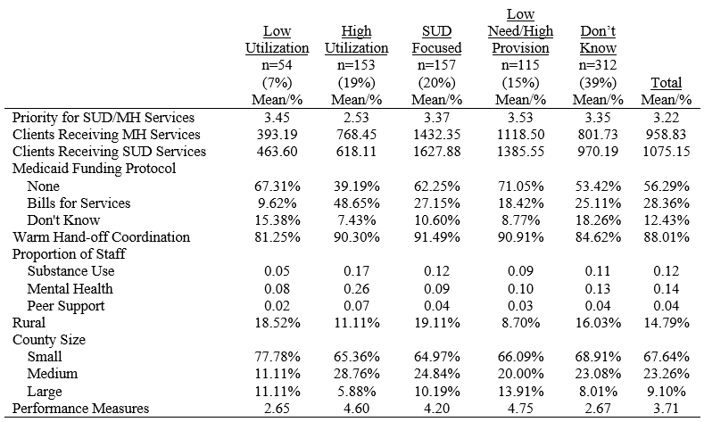
Characteristics by Class
Differences that may explain the differences in service efficiency between classes

Slide 48
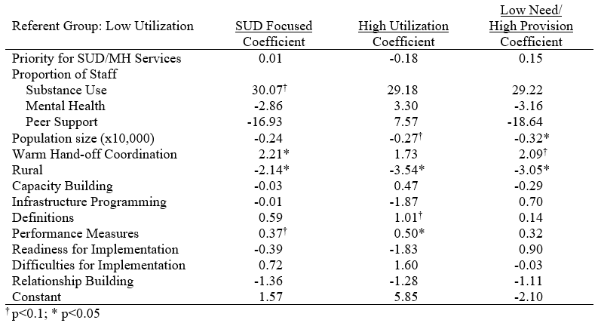
Predictors of Class Membership
Notes:
When looking at the distribution of specialized staff—not surprisingly, having a higher proportion of substance use staff is associated with being in the SUD focused class.
Increases in county population were associated with decreased odds of belonging to the high utilization and low need/high provision classes
Having a warm handoff—or directly and intentionally connecting patients with community service providers upon release—was associated with increased odds of belonging to the SUD focused and low needs group, but not the high utilization group after accounting for other covariates
Relative to the low utilization group, being in a rural community is negatively associated with all three of these classes.

Slide 49
Discussion and Implications
Rural counties have unique needs that must be addressed
Specialized staffing and Evidence-Based practices can help close the gaps in the cascade of care
Increasing jail data collection capacity and communication across agencies will help increase provision of care
Notes:
We have been communicating with our community partners and our team is actually on a call right now with them speaking specifically about this issue. Rural counties have fewer resources, lower capacity to provide care, and they are more isolated from treatment providers.
Hiring specialists in mental health and substance use can help increase provision of care within jails.

Slide 50


Questions or Comments?

Slide 51

Contact Us
Benjamin J. Mackey, MA, Research Associate
Center for Advancing Correctional Excellence!
George Mason University
email: bmackey2@gmu.edu
Twitter: @BenJMackey
Kendra J. Clark, Ph.D., Research Associate
Center for Advancing Correctional Excellence!
George Mason University
email: kclark45@gmu.edu
Twitter: @KendraJClark

